Slide 1
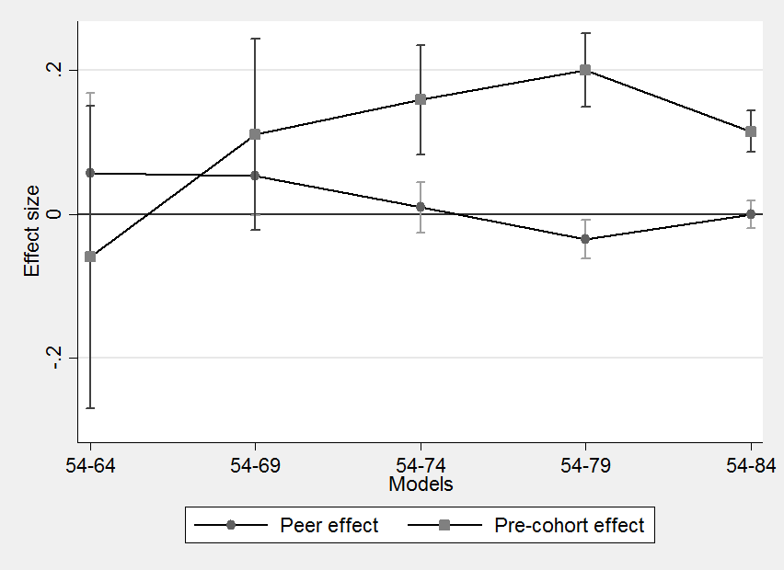
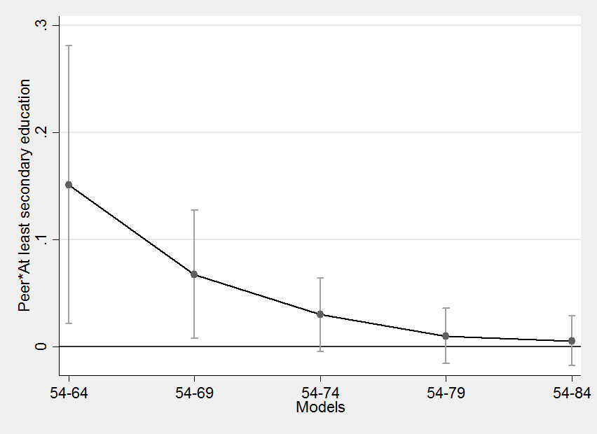
Adopting a diffusion framework to the spread of cohabitations in Italy.
Raffaele Guetto, Moreno Mancosu, Stefani Scherer, Giulia Torricelli
Italy is one of the European countries with the lowest diffusion of new family behaviour such as separation and divorce, cohabitation and extra-marital fertiltity. However, in the second half of the ‘90s, cohabitations started to spread even in Southern Europe, Italy included, concomitantly with a raise of marital instability and fertility rates.
The core hypothesis of this paper is that such increase has followed the typical pattern of a “diffusion process”, as described in the seminal work by Rogers (1983).
According to Rogers, in the early period of diffusion of an innovative behaviour, a certain part of the population, more cosmopolite, more educated and relatively less connected to the broader local context is the one which ignites the process itself. At this stage, the diffusion is driven by peer effects, i.e. a direct influence between individuals who are placed in the same segment of the society and share several structural characteristics. At later stages, the diffusion should be driven by pre-cohort effects. As long as the new behaviour spread, experiences of previous adopters become more accessible by non-adopters and, thus, even less selected segments of the social system are exposed to the innovation and prone to adopt it.
It has been claimed in the literature that parental acceptance of cohabitation is far more important in Italy than the preferences of the young and their friends. Given the Italian “familialistic” society, we hypothesise that, although the spread of cohabitations in Italy follows a general diffusion model, pre-cohort effects should be more relevant than peer effects.
We test our hypotheses on data from the ISTAT Multipurpose survey (2009), which contains retrospective information on educational, labour market and family histories. We select women born between 1954 and 1984 and apply competing risks duration models to study women’s transition to first cohabitation. Peer- and pre-cohort variables represent the cumulative experience of the same and previous cohorts respectively.
As Fig. 1 shows, peer-effects are even larger than pre-cohort effects among cohorts from 1954 to 1969, when cohabitation was a very rare event. Fig. 2 shows how peer-effects were stronger among highly educated women, consistently with the predictions of the diffusion theory. However, peer-effects seem generally little and disappear once models include women born in the ’70s, while pre-cohort effects become strong and significant.
Fig. 1 Evolution of peer- and pre-cohort effects Fig. 2 Evolution of peer-effects interacted with women’s
on the risk of experiencing cohabitation as first union. education
Coefficients from exponential duration models. Controls for are of residence, parental education (time-constant variable),
women’s educational enrolment and level and employment status (time-varying variables) not shown.
Fig. 1

