Slide 1
HousingAnywhere.com
Online housing platform for exchange and internship students
www.youtube.com/HousingAnywhere

Slide 2
Sublet your room to an incoming exchange student!
Sublet your room on www.HousingAnywhere.com
You can earn some money by subletting your room
You are sure that the exchange student will move out of your room once you return
And you will help the university with increasing the supply of short stay accommodation! And thus you will help the community of exchange students by opening up your room!

Slide 3
HousingAnywhere.com is safe!
Only students can post a room, with their student email address. This makes the platform scam free.
For renting out your room, tips to pick the right candidate:
Do a Skype interview with the room candidates
Add each other on Facebook
Ask a deposit of + 1.5 monthly rent
Use a sublease contract (a sample is on the HousingAnywhere.com website)
0 conflicts between the students have been reported to HousingAnywhere.com the last 5 years! Student-to-student concept works!

Slide 4
HousingAnywhere.com is for free
Using HousingAnywhere.com is for free
HousingAnywhere operates on a student-to-student basis.
Use your student email address to get free access
Tip: Also possible if you live with your parents: “home stay”: ask your parents first if they like to host an international student!

Slide 5
User feedback
“In 5 minutes my room was online on the platform – super easy!” Eduardo Santos, Brazil
“All rooms are offered by students, which makes it very safe!” Friederieke Koch, Germany
“When I returned to my room, everything was still in a good condition, and my Swiss subtenant even left me a box of Swiss chocolate!” Maria Korhonen, Finland
“My room in Pisa cost me 250 euros a month, and I subletted my room in Vienna for 450 euros a month; this way I could pay my language course!” Patrick Steiner, Austria

Slide 6
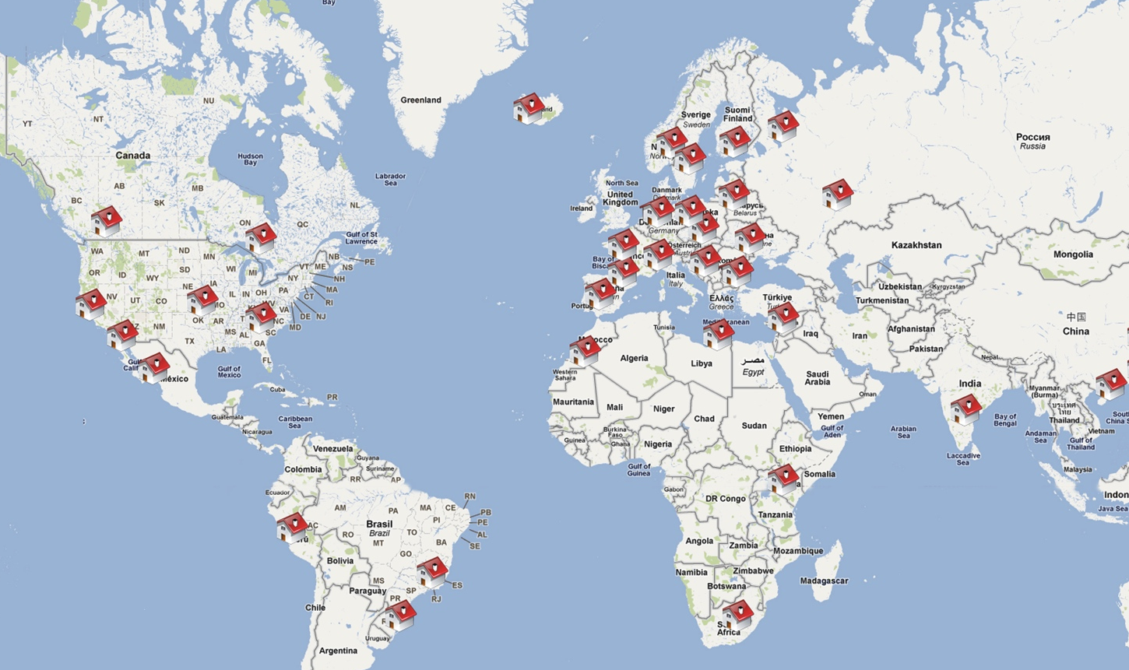
The website:

