Slide 1
Know how & Trade Secrets
Instruments of civil protection
Giovanni F. Casucci
2014

Slide 2

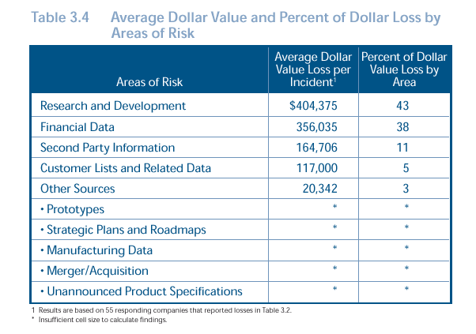

Slide 3
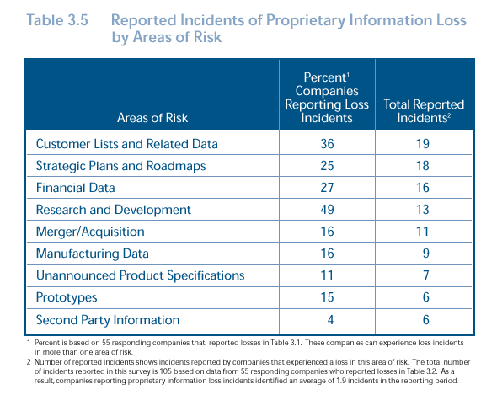

Slide 4
30
months
TIMING
of protection
.
T4
EXTENSION
BASED ON PRIORITY
T5
NATIONAL PHASE
PCT
T3
PATENT
FILING
T2
INVENTION
18 months
Under secrecy
High risk of know-how violation
12 months
18 months
under secrecy
PRIOR ART
T1
STARTR&S
Check on further prior art existence suitable to jeopardize novelty? Which reaction?

Slide 5
TRIPS agreement - art 39
1. In the course of ensuring effective protection against unfair competition as provided in Article 10bis of the Paris Convention (1967), Members shall protect undisclosed information in accordance with paragraph 2 and data submitted to governments or governmental agencies in accordance with paragraph 3.

Slide 6
TRIPS agreement - art 39
2. Natural and legal persons shall have the possibility of preventing information lawfully within their control from being disclosed to, acquired by, or used by others without their consent in a manner contrary to honest commercial practices (10) so long as such information:
(a) is secret in the sense that it is not, as a body or in the precise configuration and assembly of its components, generally known among or readily accessible to persons within the circles that normally deal with the kind of information in question;
(b) has commercial value because it is secret; and
(c) has been subject to reasonable steps under the circumstances, by the person lawfully in control of the information, to keep it secret.

Slide 7
TRIPS agreement - art 39
(10) For the purpose of this provision, “a manner contrary to honest commercial practices” shall mean at least practices such as breach of contract, breach of confidence and inducement to breach, and includes the acquisition of undisclosed information by third parties who knew, or were grossly negligent in failing to know, that such practices were involved in the acquisition.

Slide 8
Code of Industrial Property– art. 98
1. (…) corporate information and technical and industrial experience, including commercial, subject to legitimate control of the holder, if such information:
is secret in the sense that it is not, as a body or in the precise configuration and assembly of its components, generally known among or readily accessible to persons within the circles that normally deal with the kind of information in question;
have economic value because it is secret;
has been subject to reasonable steps under the circumstances, by the person lawfully in control of the information, to keep it secret.

Slide 9
SCOPE OF PROTECTION
Technical-scientific solutions
Laboratory tests
Clinical Trials
Contracts
Contents of collaboration or licensing agreements
Market Analysis
Lists of Clients
Marketing and advertising strategies
Loyalty policies (customers / suppliers)
Analysis of economic/business forecasting
Financial data
Employees data (wages, bonuses, commissions, etc.)

Slide 10
CONDITIONS FOR PROTECTION
Secrecy: limited/difficult access to this information
Economic value of such information, is meant either the cost of acquisition and the competitive advantage they conferred
Implementation of appropriate measures (security policies)

Slide 11
SECURITY MEASURES
PHYSICAL MEASURES
Restricted areas
Badges
Clean desk policies

Slide 12
SECURITY MEASURES
NON PHYSICAL/DIGITAL MEASURES
Passwords
Data criptation system
Firewalls

Slide 13
SECURITY MEASURES
Legal Measures
NDA - Non Disclosure Agreements
Confidentiality Agreements
Warning Markers

Slide 14
SECURITY MEASURES
“FINGERPRINTS”
Insertion into the information documentation of non visible/un-recognizable elements apt to reveal the origin /paternity /ownership of the information
(managed by a restrict number of people)

Slide 15
Fingerprint check

Slide 16
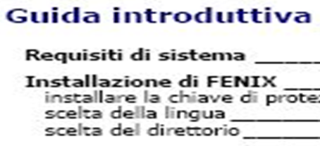
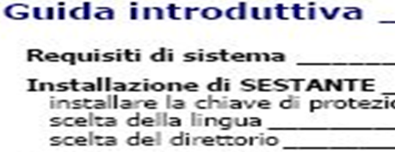
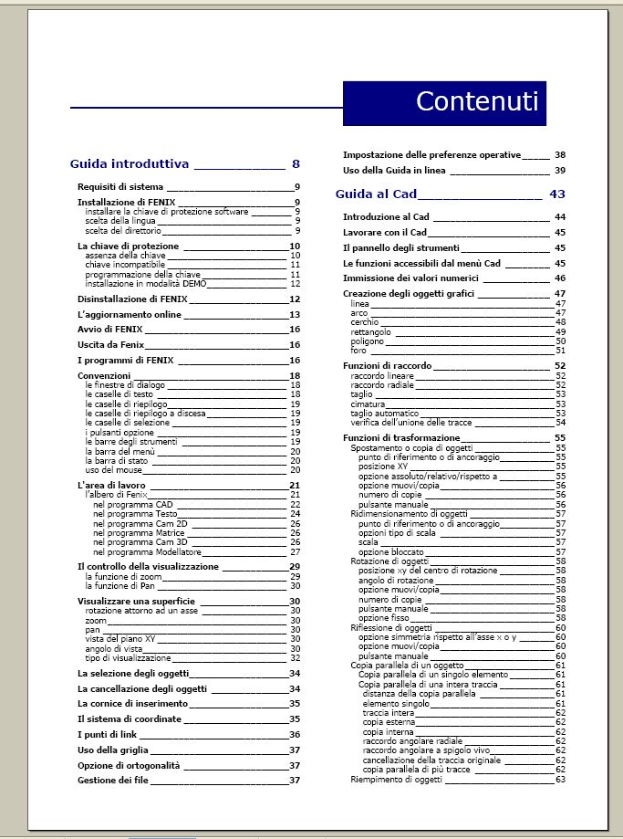
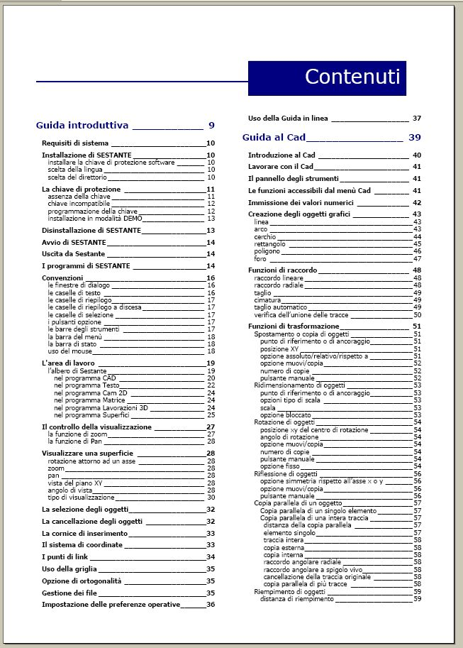

Slide 17
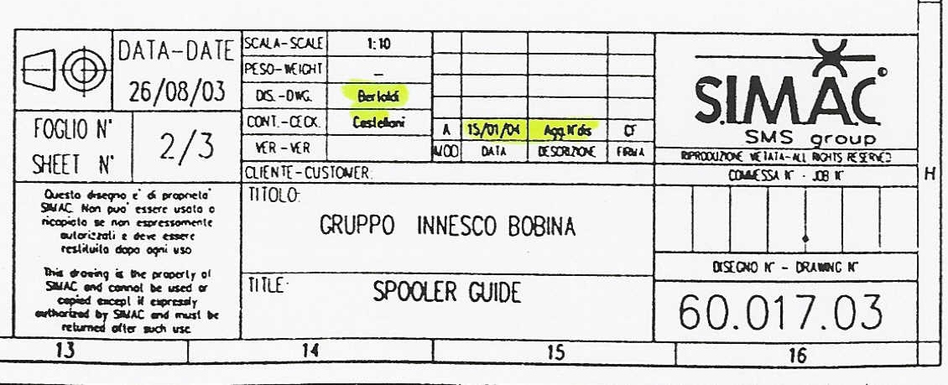

Slide 18
CRITICAL ISSUES
Proper and clear identification and evaluation of trade secrets
Implementation of mixed security measures/systems
Recognition elements (visibile and hidden)
Awarness and appropriate training (employees, free lance, consultants)
Mangement of external and internal assaults (social engineering)

Slide 19
CONTRACT CLAUSES
N.D.A. / LICENSE AGREEMENTS
  "Confidential Information" shall mean all information or data relating to the other Party’s business disclosed before or after the date of this Agreement, in any form (including, without limitation, whether in writing, orally, in a visual or an electronic form, in a magnetic, digital form or on disk or other media) to one Party (or its directors, officers, employees, agents or professional advisers) by the other Party, or by a third party on behalf of the other Party, whether directly or indirectly in connection with the Purpose. It shall include but not be limited to any information and data concerning the other Party’s operations, processes, plans, intentions, product information, inventions, know-how, design rights, trade secrets, software, network configuration, IT systems, market opportunities, customers and business affairs, and all documents, materials and other information which contain or reflect or are generated from the Confidential Information.

Slide 20
CONTRACT CLAUSES
N.D.A. / LICENSE AGREEMENTS
  but shall exclude any part of such disclosed information or data which:
    a) is in or comes into the public domain in any way without breach of this Agreement by the receiving Party (provided that Confidential Information is not deemed to be in the public domain by reason only that it is known to only a few of the persons to whom it may be of commercial interest); or
    b) the receiving Party can show by its written or other records was in its possession or known to it by being in its use or being recorded in its files or computers or other recording media prior to receipt from the disclosing Party and was not previously acquired by the receiving Party from the disclosing Party under an obligation of confidence; or
    c) the receiving Party obtains or has available from a source other than the disclosing Party without breach by the receiving Party, or such source, of any obligation of confidentiality or non-use towards the disclosing Party.

Slide 21
CONTRACT CLAUSES
N.D.A. / LICENSE AGREEMENTS
HANDLING OF CONFIDENTIAL INFORMATION
  In consideration of the delivery and/or exchange and/or disclosure of Confidential Information, X undertakes in relation to the Y Confidential Information:
    a) not to use the Confidential Information for purposes different from the mere examination for evaluating manufacturing issues; in particular not to replicate, not to modify not to destroy, not to copy the Confidential Information;
    b) to maintain the same in confidence and to use it only for the Purpose and for no other purpose and in particular, but without prejudice to the generality of the foregoing, not to make any commercial use thereof or use the same for the benefit of itself or any third party other than pursuant to a further agreement with the other Party;

Slide 22
CONTRACT CLAUSES
N.D.A. / LICENSE AGREEMENTS
HANDLING OF CONFIDENTIAL INFORMATION
  c) not to disclose any part thereof to another person;
  d) to notify the disclosing Party immediately of any breach or potential breach of the previous obligations imposed by this Agreement (including any written undertaking with a third party), and enforce such obligations at its expense and at the request of the disclosing Party in so far as breach of such obligations relates to the disclosing Party’s Confidential Information.
  e) to keep all the Confidential Information separate from all other documents and materials (and to the extent any Confidential Information is stored or held electronically, ensure that adequate security systems are in place to prevent unauthorised access), and at the receiving Party's usual place of business in YYY.

Slide 23
CONTRACT CLAUSES
N.D.A. / LICENSE AGREEMENTS
HANDLING OF CONFIDENTIAL INFORMATION
    f) to be responsible for the performance of sub-clauses a) to c) above on the part of its employees, directors or advisers to whom the Confidential Information is disclosed;
    g) without prejudice to the foregoing, to apply the other Party’s Confidential Information no lesser security measures and degree of care than those which the receiving Party applies to its own confidential or proprietary information.

Slide 24
KNOW HOW and ENFORCEMENT
Legal protection is granted according to unfair competition law:
Know how is ruled in Italian Code of Industrial Property(CPI)
Description (Search order) (art.129 + 130 CPI)
Seizure (art. 129 +130 CPI)
Injunction (art.131 CPI)

Slide 25
KNOW HOW and ENFORCEMENT
DESCRIPTION AND SEIZURE
(129 CPI)
1. The owner of an industrial property right may request a description or seizure and as well as the seizure subject to the description, some or all of the items infringing the right, as well as' the means used in producing the same and the elements of evidence concerning the alleged violation and its extent. It has to be taken appropriate measures to ensure the protection of confidential information.

Slide 26
KNOW HOW and ENFORCEMENT
DESCRIPTION AND SEIZURE
(130 CPI)
1. Description and seizure shall be executed by a bailiff, with the assistance, where appropriate, one or more experts and also with the use of technical means of verification, photographic or otherwise.
2. Claimant may be authorized to attend the operations even through their representatives and to be assisted by technicians of their choice.

Slide 27
KNOW HOW and ENFORCEMENT
INJUNCTION
(131 CPI)
1. The owner of an industrial property right is entitled to ask that the injunction of any imminent infringement of his rights and the continuation or repetition of the current violations, and in particular may request to be ordered an injunction prohibiting the manufacture, trade and use of infringing items, and order the recall of the same items against whoever is the owner or has, however, the availability, [...]. The injunction and order of the recall can be applied on the same conditions, against any person whose services are used to infringe an intellectual property right (1).

Slide 28

Studio Legale Casucci
Ferretti STP
Viale Regina Margherita 35
20122 Milano
T +39.(0)2.87389450
F +39.(0)2.87389452
milano@bardehle.eu
Piazza Bra 28
37121 Verona
T +39.(0)45.9230185
F +39.(0)45.9230186
verona@bardehle.eu
Santa Croce 2122
30135 Venezia
T +39.(0)41.0991600
F +39.(0) 41.0991619
venezia@bardehle.eu
www.bardehle.com
GIOVANNI F. CASUCCI
Avvocato
Direttore del Master ICE in Proprietà Industriale “IDEACINA”,
Co-Direttore del Corso di Formazione Permanente in Proprietà Industriale – Politecnico di Milano
Docente della Faculty permanente del MIP Politecnico di Milano
Coordinatore Commissioni Design e Fiere presso il CNAC
Esperto esterno IP accreditato presso il programma IPR2, Beijing
Esperto esterno IP accreditato presso il programma IPR SME HELPDESK Beijing
Membro di IBA, LES, AIPPI e ECTA.

