Slide 1
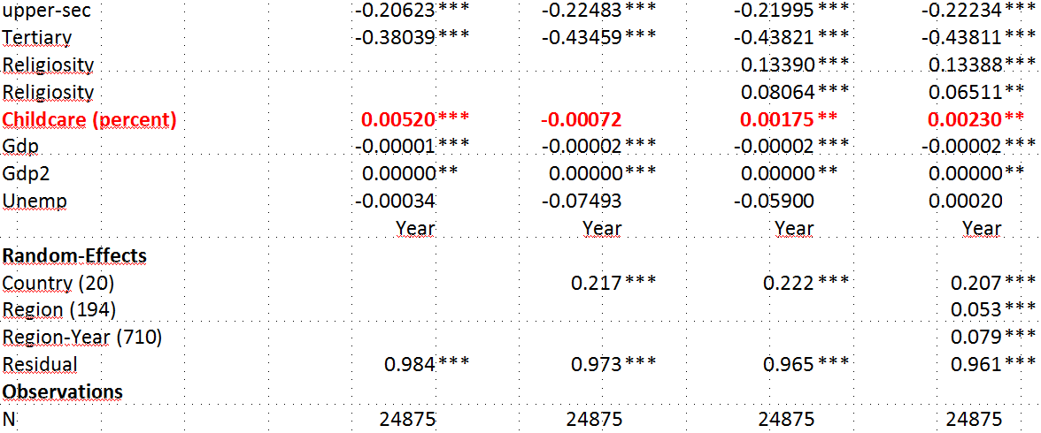
Education and Fertility: the moderating role of public childcare services
Raffaele Guetto and Stefani Scherer
Although theoretically well-established, the childcare-fertility nexus did not find a very strong empirical support. This depends, first of all, on the difficulties in the operationalisation of childcare services and in the identification of their “causal” effects. Childcare availability is associated indeed to unobserved cultural characteristics which need to be taken into account. Moreover, heterogeneity at the individual level is often overlooked. Families indeed react very differently to changes in the availability of childcare services and education has been considered a crucial factor. Family policies are often more effective on the labour market participation of low-educated women, while positive effects on fertility have been found only among tertiary educated ones. Cross-national differences in Total Fertility Rates have been traced back to the different behaviours of tertiary educated women, since the availability of public childcare services in some countries is deemed to help them to catch-up on fertility after initial postponement.
Tab. 1 The effect of childcare availability on fertility
We use data on regional enrolment rates of children aged<3 in public childcare institutions, collected for 198 regions and 20 countries for the time-window 2000-2011. Data have been retrieven from national administrative and other available data sources (see Fig. 1) and merged to 5 waves of the ESS (2002-2010).
Empirical evidence shows how childcare effects can be detected only after controlling for religiosity at the individual and regional level, as well as other unobserved characteristics at the regional level (captured by region random effects, see Tab.1).
Fig. 2 Interaction between childcare, women’s education and age
Moreover, results show how the number of children women have barely changes according to childcare before they turn 35, regardless of their education. On the contrary, childcare availability seems to help educated and especially high-educated women to catch up on fertility after the age of 35 (see Fig.1).
Paper presented at the RC28 Spring Meeting (2014) held in Budapest, May 8-10.

