Slide 1


UC CEAS Dual Articulation and Graduate Programs for International Students
COLLEGE OF
ENGINEERING & APPLIED SCIENCE

Slide 2
Graduate Degree Programs
Aerospace Engineering
Additive Manufacturing
Artificial Intelligence
Biomedical Engineering
Chemical Engineering
Civil Engineering
Computer Engineering
Computer Science
Electrical Engineering
Environmental Engineering
Environmental Science
Materials Science & Engineering
Mechanical Engineering
Robotics & Intelligent Autonomous Systems
COLLEGE OF
ENGINEERING & APPLIED SCIENCE

Slide 3
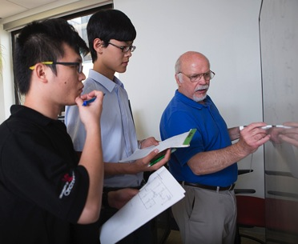
Dual MSc/MEng Program
Master of Science from Home University
Master of Engineering from UC
COLLEGE OF
ENGINEERING & APPLIED SCIENCE

Slide 4
UC Master of Engineering (MEng) Program
Industry focused graduate degree that provides:
  Advanced technical skills
  Professional skills (leadership and teamwork)
Coursework + capstone project/internship
No thesis required for UC MEng degree
Completed in less than 1 year at UC
COLLEGE OF
ENGINEERING & APPLIED SCIENCE

Slide 5
Benefits of the Dual Degree Program
Graduate degrees from two universities
  Top-ranked Italian University
  Top-ranked U.S. University
Diverse coursework and faculty
  Broader selection of topics
  Experts from two continents (USA + EU)
  Possibility of degree combinations (ex. Mechanical Engineering + Civil Engineering)
COLLEGE OF
ENGINEERING & APPLIED SCIENCE

Slide 6
Dual Degree Program at a Glance (Spring Enrollment at UC)
Semesters | Dual Degree, 1-Semester at UC completion option | Dual Degree, 2-Semester at UC completion option
Fall Semester | Academic Semester at UniTN, transfer 15 credits to UC | Academic Semester at UniTN, transfer 15 credits to UC
Spring Semester (approx. Jan – end Apr) | Academic Semester at UC (12 credits plus 3 credits Capstone project on campus) | Academic Semester at UC, 12 credits, 4 classes
Summer Semester (approx. May – Aug) | Return to Home University | Complete 3 credits Capstone Project as Internship or at UC, 3 credits, written report
MSc (UniTN) and MEng (UC) awarded after completion of coursework and capstone
* All dates are approximate and will adjust to a new academic calendar
COLLEGE OF
ENGINEERING & APPLIED SCIENCE

Slide 7
Dual Degree Program at a Glance (Fall Enrollment at UC)
Semesters | Dual Degree, 2-Semester | Dual Degree, 3-Semester
Spring Semester (Summer Semester OFF) | Academic Semester at UniTN, transfer 15 credits to UC | Academic Semester at UniTN, transfer 15 credits to UC
Fall Semester (approx. Aug – Dec) | Academic Semester at UC (12 credits plus 3 credits Capstone project on campus) | Academic Semester at UC, 12 credits, 4 classes
Spring Semester (approx. Jan – Apr) | Return to Home University | Complete Capstone Project as Internship or at UC, 3 credits, written report
MSc (UniTN) and MEng (UC) awarded after completion of coursework and capstone
* All dates are approximate and will adjust to a new academic calendar
COLLEGE OF
ENGINEERING & APPLIED SCIENCE

Slide 8
Admission Requirements
Bachelor’s degree in corresponding program with 3.0 GPA or equivalent
TOEFL of 85 or better/IELTS 6.5/Pearson Test of English of 49
GRE not required if recommended for admissions by home University
Approved F-1 visa (form I-20) for two semesters
COLLEGE OF
ENGINEERING & APPLIED SCIENCE

Slide 9
Spring Semester Admission Application Timeline
Briefing with students on the process | Any time prior to deadline
Application Deadline | Late-October
List of recommended candidates to UC * | As apply, by early November
Offer letters from UC to students | Within 10 days or sooner
* Approved students apply online at UC CEAS.
COLLEGE OF
ENGINEERING & APPLIED SCIENCE

Slide 10
Fall Semester Admission Application Timeline
Briefing with students on the process | Any time prior
Application Deadline | Late April, the earlier the better
List of recommended candidates to UC * | As apply, by mid April
Offer letters from UC to students | Within 10 days or sooner
* approved students apply online at UC CEAS.
COLLEGE OF
ENGINEERING & APPLIED SCIENCE

Slide 11
Application Process
Send a list of eligible students and transcripts to CEAS for review of credentials
University Online Application – https://grad.catalyst.uc.edu/apply/
  Students create a new account by using the link above and submit transcripts, TOEFL scores, statement of purpose and provide names and contact information of two references.
  If intending to study in Spring students must apply for Fall, upon completion of application send an email to: engrgrad@uc.edu stating that you have applied to the Dual Degree program and we will change your admission date to Spring.
  There is an USD$80.00 application fee. Fees are paid by credit card.
COLLEGE OF
ENGINEERING & APPLIED SCIENCE

Slide 12
Application Process
Step 2:
Review Process
  Upon completion of the above application process your file will be reviewed and you can check your status online at: https://grad.uc.edu/admissions.html
Step 3:
Application Approval
  Approved applications will be confirmed and an email will be sent from our International Office (international.students@uc.edu ) on what is required to prepare your I-20.
COLLEGE OF
ENGINEERING & APPLIED SCIENCE

Slide 13
Application Process
Step 4:
International Office and I-20 Issuance
  Additional information about I-20’s can be found on our International Students website http://www.uc.edu/international/services/students/prepare/i-20_faq.html
  We recommend that you have your I-20 / DS-2019 mailed by express mail. Regular mail overseas may take as long as 4- 6 weeks
COLLEGE OF
ENGINEERING & APPLIED SCIENCE

Slide 14
Program Costs
1st semester at UC:
  $14,914 tuition and fees ($5,320 guaranteed scholarship available)
  Approximately $5,000 - $6,000 room and board
2nd semester at UC:
  Some students elect to stay & complete an internship/capstone project in the 2nd semester. Costs same as the 1st semester, scholarship available
  $14,914 tuition and fees ( ~9k+ scholarship available)*
*2019-2020 tuition and fees, not including cost of living
Subject to annual price adjustment
COLLEGE OF
ENGINEERING & APPLIED SCIENCE

Slide 15
Capstone Project (3-6 credit)
Pathway A: Completed as part of 15 credits at UC lab in the 1st semester
Pathway B: Completed as an internship in industry (via Curriculum Practical Training, CPT) during the 2nd semester for select project
  Must find internship by the end of the 1st semester to qualify for CPT
Pathway C: Completed at UniTN
  An outline/abstract required
  All require written report submitted to UC upon completion
COLLEGE OF
ENGINEERING & APPLIED SCIENCE

Slide 16
Pathway B: Internship (CPT)
Curriculum Practical Training (CPT)
Working for company or research lab (paid)
Students must register for a minimum of 12 credit hours during the second semester at UC to satisfy F-1 visa requirements.
Students responsible for finding internship
  Help available through UC Career Center / job fairs
  Many students use connections through LinkedIn
  Search online job postings
COLLEGE OF
ENGINEERING & APPLIED SCIENCE

Slide 17
CPT / OPT
Interested & qualified students can apply for CPT (curriculum practical training) for Capstone project during 2nd semester
Interested & qualified students on valid F-1 visa can apply for OPT (optional practical training) upon completion of 2 full-time semesters at UC
Apply for 12 months initial OPT within 90 days before and 60 days after degree completion
COLLEGE OF
ENGINEERING & APPLIED SCIENCE

Slide 18
UC Graduation
Students completing Capstone in Fall semester apply for Fall Graduation:
  Deadline to apply for Fall Graduation is September. Actual graduation date is in December.
Students completing Capstone in Spring semester apply for Spring Graduation:
  Deadline to apply for Spring Graduation is January. Actual graduation date is in May.
COLLEGE OF
ENGINEERING & APPLIED SCIENCE

Slide 19

UC Graduation Cont.
Students completing Capstone in Summer apply for Summer graduation:
  Deadline to apply for Summer graduation is May. Actual graduation date is August.
Online graduation application:
  Graduation website http://grad.uc.edu/student-life/graduation.html
  Graduation application fee is $50.00 (non-refundable)

Slide 20
UC Housing
On campus options: http://www.uc.edu/uchousing/residence_halls.html
Off campus options: http://www.uc.edu/uchousing/graduate_housing.html
COLLEGE OF
ENGINEERING & APPLIED SCIENCE

Slide 21
F-1 and I-20
The I-20 is the "Certificate of Eligibility,” meaning a student is "eligible" to apply for an F-1 student visa
After receiving an I-20 from UC, students make an appointment to apply for the F-1 visa at the local U.S. embassy or consulate.
Students must present both the F-1 visa and the I-20 to a U.S. Immigration inspector upon arrival at the port-of-entry.
COLLEGE OF
ENGINEERING & APPLIED SCIENCE

Slide 22
UC Master of Engineering (MEng) Program
Industry focused graduate degree that provides:
  Advanced technical skills
  Professional skills (leadership and teamwork)
Coursework + capstone project/internship
No thesis required for UC MEng degree
Completed in less than 1 year (2 semesters) at UC (30 credits)
COLLEGE OF
ENGINEERING & APPLIED SCIENCE

Slide 23
UC MEng Program
1st year
  Work on coursework
  Decide whether you intend to work on a project or not – find a project advisor if yes
2nd year
  Finish coursework in the Fall
  Finish project and present
  or
  Undergo final examination
COLLEGE OF
ENGINEERING & APPLIED SCIENCE

Slide 24
Types of Research Degrees
Masters of Science (MS)
Research based
Thesis required
Completion in 3-4 semesters
PhD (direct route or post-MS)
Research based
Dissertation required
Completion 6–10 semesters
COLLEGE OF
ENGINEERING & APPLIED SCIENCE

Slide 25
Research Pathways
Environment
Water/Air Quality, Fuel Efficiency, Transportation, Sustainable Engineering and Energy
Information Science
Modeling and Simulation, Bioinformatics, Cybersecurity, Data Mining
Manufacturing
Advanced Manufacturing, Materials, CAE, Robotics, Intelligent Systems
Sensing
Nanotechnology, Microfluidics, Structural Integrity and Dynamics, Smart Structures and Systems
Health
Tissue Engineering, Chemical Separations, MEMS diagnostics, Medical Devices
COLLEGE OF
ENGINEERING & APPLIED SCIENCE

Slide 26
UC Master of Science Program
1st year
  Finish most required coursework (20 credit hours of “real” courses)
  Formulate thesis topic & complete preliminary studies/literature review/etc.
  Select thesis committee and defend proposal
2nd year
  Finish coursework in the Fall
  Work in earnest on your research
  Defend your thesis
COLLEGE OF
ENGINEERING & APPLIED SCIENCE

Slide 27
UC PhD Degree Program
1st year
  Finish coursework (12 credit hours past MS)
  Formulate dissertation topic & complete preliminary studies/literature review/etc.
2nd year and following
  Take qualifying exam in the Fall Semester
  Form committee and defend proposal
  Work in earnest on your dissertation
COLLEGE OF
ENGINEERING & APPLIED SCIENCE

Slide 28
Graduate Programs Reasonable Progress
MEng:
Semi-annual Performance Review, 15 months
MS:
Annual Performance Review, 24 months
PhD Degree:
Annual Performance Review, 48 months
COLLEGE OF
ENGINEERING & APPLIED SCIENCE

Slide 29
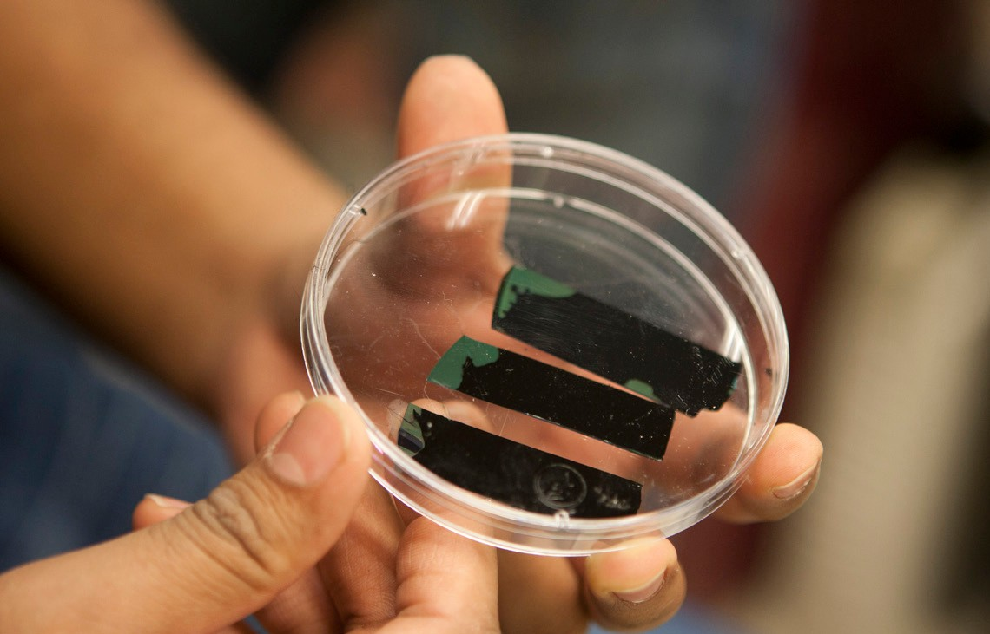
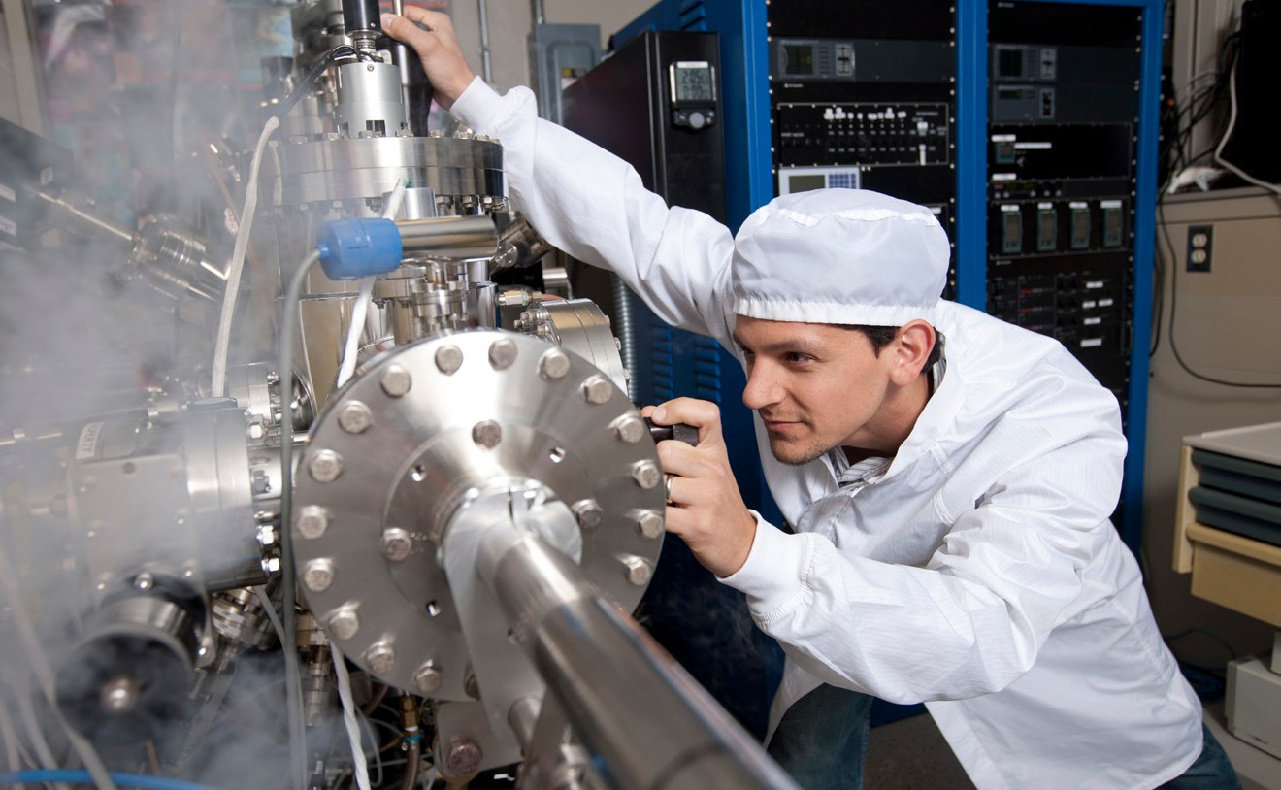
Research Infrastructure
CEAS has many outstanding
CEAS has many outstanding research centers, institutes and labs. For a complete listing visit: http://www.ceas.uc.edu/research/ research_labs_andcenters.html
COLLEGE OF
ENGINEERING & APPLIED SCIENCE

Slide 30
Funding
All applicants for full-time graduate study are considered for financial aid, no separate form is required.
For priority consideration applications must be complete by January 15 for the first round review and decisions for fall semester admission.
Applications will still be accepted through April 1
Graduate Assistantships:
  Competitive research and teaching assistantships are available with a minimum stipend of $22,100.
  CEAS offers tuition and fee waivers of $20,800 to a maximum of $29,346 per year.
  *Rates are subject to annual adjustment
COLLEGE OF
ENGINEERING & APPLIED SCIENCE

