Slide 1


Introducing
the Network

Slide 2


Agenda

Slide 3
SCHOLARS AT RISK (SAR) is an international network of higher education institutions and associations whose mission is to protect threatened scholars and promote academic freedom.

Slide 4
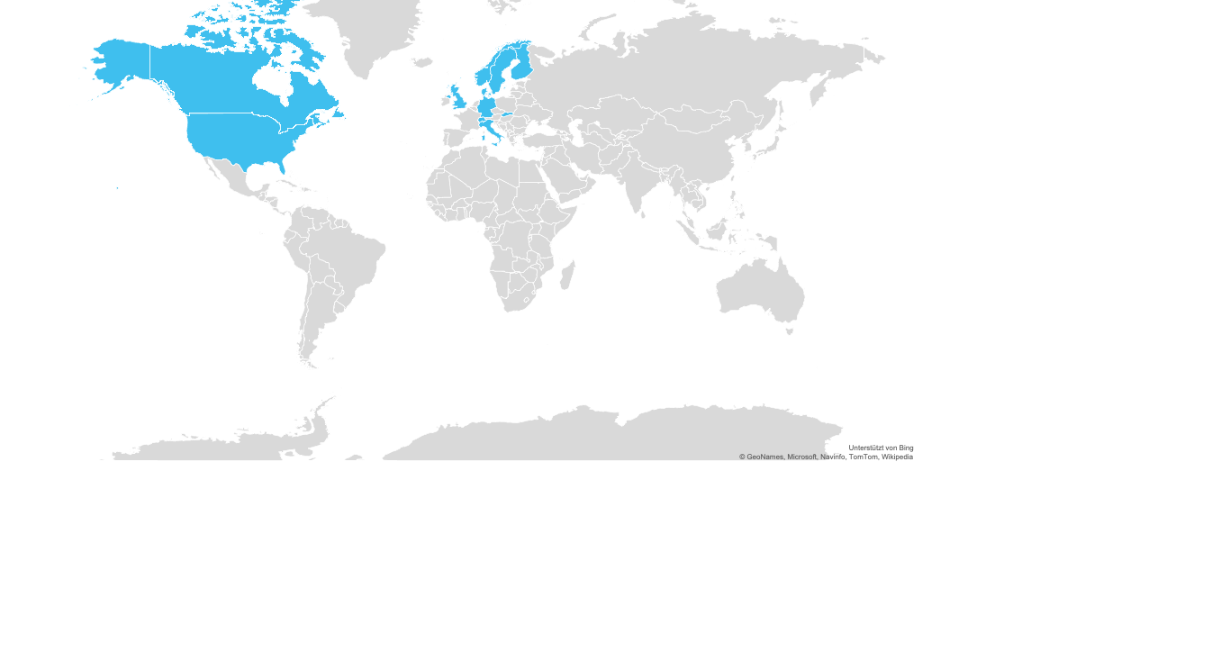
SAR is represented by more than 550 institutions in 42 countries.
SAR Sections currently exist in 13 countries.
DUBLIN
SAR Europe
Headquarters
NEW YORK
SAR United States
Headquarters

Slide 5
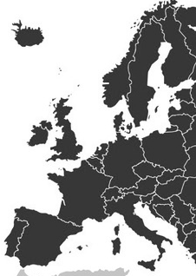


SAR Europe
Is hosted at Maynooth University in Ireland, and reflects a mutual commitment to the principle of academic freedom
Coordinates the activities of over 300 member universities in
Europe including national SAR sections in 11 European countries and the 10-partner H2020 project Inspireurope
Aims to strengthen a collective voice across institutions in order to contribute to informed policymaking

Slide 6



SAR’s work encompasses three key areas
PROTECTION
ADVOCACY
LEARNING

Slide 7

Protection

Slide 8
300+
SAR protects scholars suffering grave threats to their lives, liberty, and well-being by arranging temporary research and teaching positions, and by providing advisory and referral services.
threatened scholars worldwide are provided with sanctuary and assistance through SAR every year.

Slide 9
SAR’s Protection work includes:
Scholar applications and referrals: SAR evaluates each scholar’s situation, helping them to navigate resources to support them personally and academically
Visiting academic appointments: SAR works with network institutions to arrange short- to medium-term academic visits (6 months to 2 years) at universities, colleges, think tanks
Transition assistance: SAR advises and assists scholars in their relocation and adjustment, acquisition of new academic/professional skills, and networking.
In the most urgent situations, SAR may be able to offer direct financial support
Growing a network of support: SAR advises universities, associations, and governments on establishing new protection programs and projects

Slide 10
In the 2019–2020 academic year, SAR received almost 500 applications for assistance and arranged placements for 143 scholars from a wide variety of disciplines.

Slide 11
Of those scholars, the majority requiring assistance came from Turkey, Syria, Yemen, Iran, or Brazil.

Slide 12
How SAR Helps Individual Scholars
STEP 1
STEP 2
STEP 3
STEP 4
Initial Evaluation
SAR evaluates the scholar’s situation to determine how SAR and the network can best help them.
Scholar Hosting
The scholar may be hosted for a visiting academic position at a network institution.
Advice & Assistance
The scholar receives advice and assistance on relocation, integration adjustment, job skills, and more from SAR and the host institution.
Transition
The scholar receives
support from SAR to transition to longer-term opportunities.
Scholar applies
(or is referred)

Slide 13
Identifying Scholars to Host
SAR maintains clear and regular communication with universities interest in hosting. We reach out to the network to find a good academic fit for scholars urgently seeking temporary placements.
We Recommend
Contacting SAR staff to discuss next steps and fit once there is interest in hosting on campus
Building a committee of interested university contacts available to participate in hosting discussions
Starting these conversations with SAR ~6 months before ideal start date
To ensure a strong academic match, some aspects to consider include
Purpose of hosting an at-risk researcher
Geography/diversity of candidates
Discipline/field
Risk
Academic training/experience
Publications
Language
Family
Academic mentors on campus
Notes:
Next steps for universities:
Review scholar packets
Invite the scholar to interview in person or via skype
Prepare an offer letter for a temporary position
Work with SAR staff to prepare for arrival

Slide 14
Advocacy

Slide 15
341
SAR has established several initiatives to identify, document, and take action in response to attacks on scholars, students and their higher education communities.
attacks against higher education communities were documented in SAR’s Free to Think 2020

Slide 16
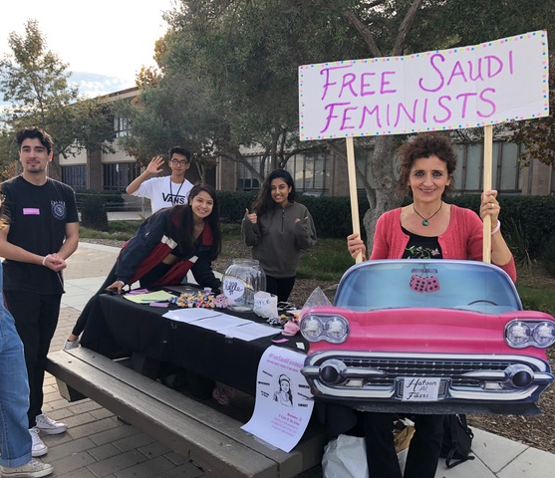
SAR’s Advocacy work includes:
Monitoring attacks on academic freedom
Advocating for imprisoned scholars
Advising university students in advocacy efforts through seminars and legal clinics
Demanding accountability and action through supranational, international, regional, and inter-state systems

Slide 17

Academic Freedom Monitoring Project
SAR secretariat staff and volunteer researchers around
the world identify, document, and report on attacks on
higher education.
THE GOAL
Raising awareness
Generating data-driven advocacy
Increasing protection for scholars, students,
and academic communities
Promoting respect for academic freedom
and higher education quality

Slide 18
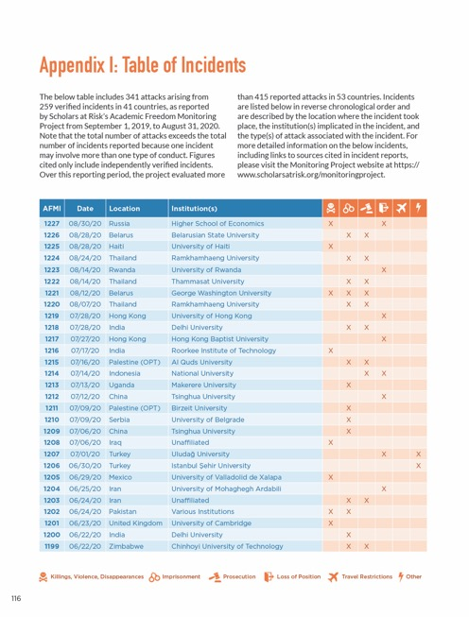
Free to Think Report
SAR’s annual report analyzes thematic and regional trends and ongoing issues. In the period between September 1, 2019 to August 31, 2020, Free to Think 2020 chronicled 341 reported attacks against higher education communities.
WHAT IT INCLUDES:
Violent attacks on higher education communities
Wrongful imprisonments and prosecutions of scholars
Pressures on student expression
Legislative and administrative threats
COVID-related issues

Slide 19
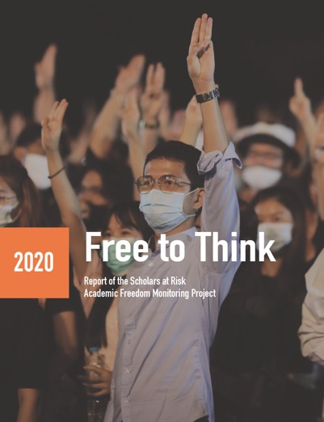
Free to Think 2020
SAR’s Free to Think 2020 reports the following:
124 incidents of violent attacks on higher education communities in 42 countries
96 incidents of wrongful imprisonment and 52 incidents of wrongful prosecution
Current challenges posed by the COVID-19 pandemic:
  Using the crisis to crackdown on activists
  Attacks on COVID-related research & expression
  Suspended asylum procedures in many countries
  Limited resources to respond to increasing needs for support

Slide 20
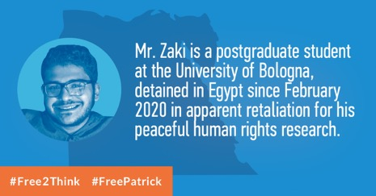

Scholars in Prison Project
This project coordinates advocacy activities on behalf of scholars and students facing prosecution or imprisonment.
THE GOAL
Robust case intake process
Range of advocacy in coordination with family, legal counsel, and partner organizations
Leverage Student Advocacy Seminars and Legal Clinics to play a crucial role in advocacy for the Scholars in Prison Project

Slide 21
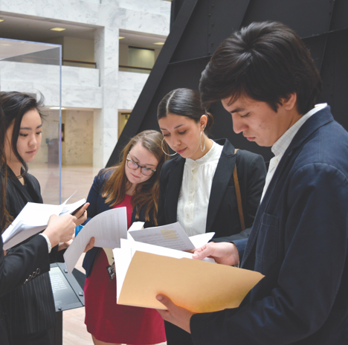
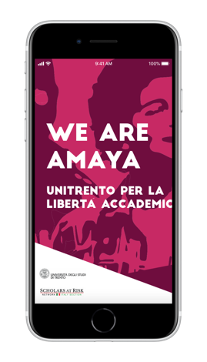
Student Advocacy Seminars
These seminars encompass faculty-led human rights research and advocacy at SAR member institutions.
THE GOAL
Conduct research and advocacy for Scholars
in Prison cases
Collaboration across seminars, with partner
organizations, and families
Seminars as for-credit courses or hybrid models
Organizing campaigns through social media,
campus organizing, media and press, local and
national governments, and the United Nations

Slide 22
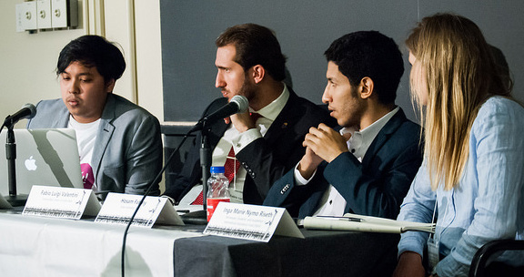
Academic Freedom Legal Clinics
These seminars encompass faculty-led human rights research and legal analysis at SAR member institutions.
THE GOAL
Monitoring and reporting to SAR on attacks on higher education locally, or in countries of interest
Legal analysis at local, regional or international level
Development of advocacy in response to particular attacks
Clinics are generally led by one faculty member, with 5-10 participants (typically, but not exclusively), at the graduate level

Slide 23
Learning

Slide 24
4865
SAR convenes faculty, students
and higher education community members to discuss global and regional academic freedom climates and to develop solutions that strengthen the university space.
total learners to date for MOOC online course

Slide 25
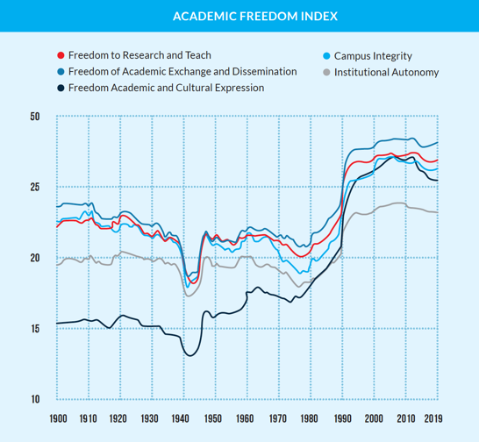
SAR’s Learning work includes:
Hosting virtual conferences and workshops
Offering a MOOC and other open-source learning opportunities on pressing academic freedom concerns
Collaborating with global partners on the annual Academic Freedom Index
Conducting surveys and issuing reports on national regional, and international academic freedom issues Coordinating speaker series of SAR scholars across network institutions
Opening global conversations through podcasts and other accessible platforms

Slide 26
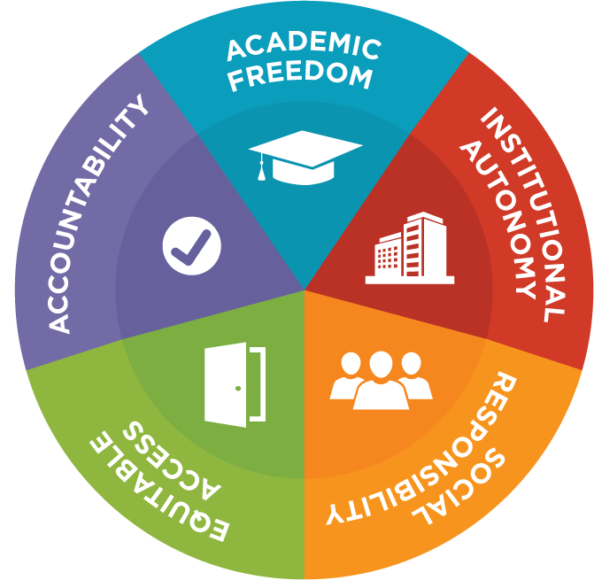
Promoting Core Higher Education Values
A proactive framework that recognizes the interconnectedness of core higher education values that maintain a healthy space to think, question, and share ideas.
THE GOAL
Build understanding and respect for higher education
values and their contributions to society
Avoid “pitfalls” of neglect and oversimplification
Provide a framework for dialogue and analyzing
values-related incidents
Develop expanded menu of pro-values responses to incidents

Slide 27
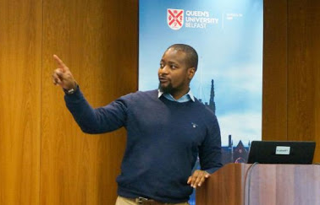
Scholar Speaker Series
The Vivian G. Prins Speaker Series offers an opportunity for SAR network institutions to invite to campus one or more scholars, each with a powerful and unique story to share.
THE GOAL
Educate campus communities and the public about threats to academic freedom and attacks on scholars
Provide an opportunity for organizations to invite at-risk scholars for short visits to share their powerful stories in a personal, meaningful way

Slide 28

Thank you.
VISIT
www.scholarsatrisk.org
EMAIL
info@scholarsatrisk.org
CONNECT
@ScholarsAtRisk

